Slide 1
Matilde Monteiro-Soares
David Russell
Edward J Boyko
William Jeffcoate
Joseph Mills
Stephan Morbach
Fran Game
www.iwgdfguidelines.org

Slide 2
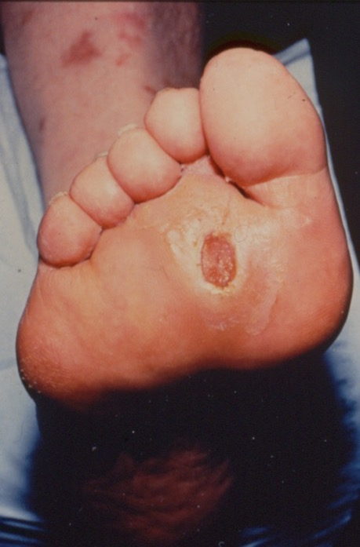
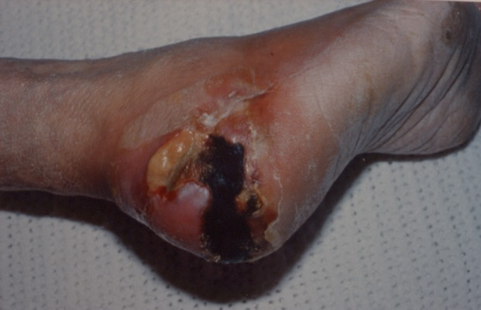
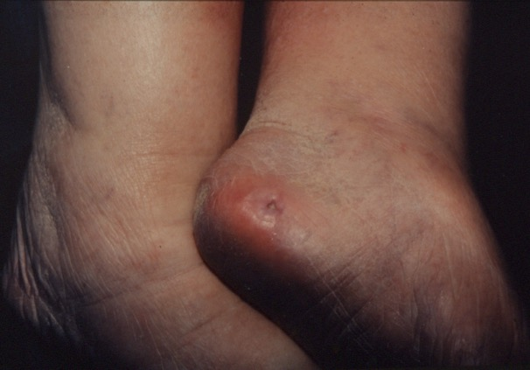
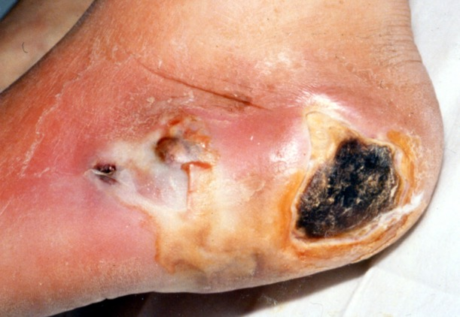
Diabetic Foot Ulcers- why do we need to classify?
Slides courtesy IWGDF; available at: www.iwgdfguidelines.org
Different causes – predisposition/ delayed healing
Different outcomes – healing /amputation
Different management strategies– offloading/infection/revascularisation

Slide 3
In which clinical situations would classification be useful?
Slides courtesy IWGDF; available at: www.iwgdfguidelines.org
Communication among health professionals about the characteristics of a diabetic foot ulcer
To assess an individual’s prognosis with respect to the outcome of their diabetic foot ulcer
To guide management in the specific clinical scenario of a patient with an infected diabetic foot ulcer
To aid decision-making as to whether a patient with a diabetic foot ulcer would benefit from revascularisation of the index limb
To support regional/national/international audit to allow comparisons between institutions

Slide 4
Methodology
Slides courtesy IWGDF; available at: www.iwgdfguidelines.org
Develop our own scoring system
Published large clinical cohorts
8 clinical features associated with outcome (healing, amputation, mortality)
Patient factors: End stage renal disease
Limb factors: Peripheral artery disease; loss of protective sensation
Ulcer factors: Area; depth; location (forefoot/hindfoot);
number (single/multiple); infection.

Slide 5
Currently published classifications: Quality and recommendations
Slides courtesy IWGDF; available at: www.iwgdfguidelines.org
Quality of evidence :
(i) presence and number of reliability (inter- observer agreement) studies
(ii) internal and external validation studies
Strength of recommendations:
(i) quality of evidence
(ii) complexity and components of the classification
(iii) number of 8 clinically important variables included

Slide 6
Slides courtesy IWGDF; available at: www.iwgdfguidelines.org

Slide 7
Slides courtesy IWGDF; available at: www.iwgdfguidelines.org
PICO: In individuals with an active DFU, which classification system should be used in communication between health professionals to optimise referral ?
Recommendation 1: Use SINBAD classification system for communication between health professionals (GRADE recommendation: Strong; Quality of evidence: Moderate)

Slide 9
Slides courtesy IWGDF; available at: www.iwgdfguidelines.org
PICO: In individuals with an active DFU, which classification system should be used in communication between health professionals to optimise referral ?
Rationale: simple and quick, no specialist equipment, 6/8 of important clinical measures, validated for healing and amputation, good reliability
For communication use individual clinical descriptors rather than total score
Recommendation 1: Use SINBAD classification system for communication between health professionals (GRADE recommendation: Strong; Quality of evidence: Moderate)

Slide 10
Slides courtesy IWGDF; available at: www.iwgdfguidelines.org
PICO: In individuals with an active DFU, which classification/scoring system should be considered when assessing an individual patient to estimate his/her prognosis ?
Recommendation 2: Do not use any of the currently available classification/scoring systems to provide individual patient prognosis (Strong; Weak)

Slide 11
Slides courtesy IWGDF; available at: www.iwgdfguidelines.org
PICO: In individuals with an active DFU, can any classification/scoring system aid decision making in specialty areas to improve healing and/or reducing amputation risk?
Recommendation 3: In a person with diabetes and an infected foot ulcer, use IDSA/IWGDF classification to characterise and guide infection management (Weak; Moderate)
Recommendation 4: In a person with diabetes and a foot ulcer, who is being managed in a setting where appropriate expertise in vascular intervention is available, use WIfI scoring to aid decision making in the assessment of perfusion and likelihood of benefit from revascularisation (Weak; Moderate)

Slide 12
Slides courtesy IWGDF; available at: www.iwgdfguidelines.org

Slide 13
Slides courtesy IWGDF; available at: www.iwgdfguidelines.org

Slide 14
Slides courtesy IWGDF; available at: www.iwgdfguidelines.org
Rationale: Both classifications have been validated on multiple occasions for various clinical outcomes with consistent results and presented adequate reliability values. So, the quality of the evidence was considered to be strong. Due to their complexity and limited assessment in different populations and contexts, however, a weak strength of recommendation was given.

Slide 15
Slides courtesy IWGDF; available at: www.iwgdfguidelines.org
PICO: In individuals with an active DFU, which classification/scoring system should be considered for regional/national/international audit to allow comparisons between institutions?
Rationale: simple and quick, no specialist equipment, 6/8 of important clinical measures, validated for healing and amputation in diverse populations of patients with diabetes and an ulcer of the foot, acceptable by clinicians in UK NDFA (>20,000 patients)
Recommendation 5: Use the SINBAD system for any regional/national/international audit to allow comparisons between institutions on the outcomes of patients with diabetes and an ulcer of the foot (Strong; High)

Slide 16
Slides courtesy IWGDF; available at: www.iwgdfguidelines.org
Considerations:
We were unable to recommend any of the currently available classification/ scoring systems to provide an individual prognosis, which would guide management and could help the patient/family. Future research should be directed to develop and validate a simple reproducible classification system for the prognosis of the individual person with a diabetic foot ulcer, their index limb or their ulcer.
None of the currently validated systems contained all 8 of the important prognostic clinical features identified as part of the review process. Future research should be undertaken to establish whether increasing the complexity of classifications by the addition of features such as ESRD, single/multiple ulcers, more detailed site of ulcers (such as plantar/dorsum) or more detailed measures of limb ischaemia significantly improves the validity of the system to predict the outcome, without compromising reliability or clinical utility.
We consider that there may never be a single DFU classification system, since the specification of any classification will depend heavily on its purpose and clinical setting.

Slide 17
Slides courtesy IWGDF; available at: www.iwgdfguidelines.org
Acknowledgments:

Slide 18
Matilde Monteiro-Soares
David Russell
Edward J Boyko
William Jeffcoate
Joseph Mills
Stephan Morbach
Fran Game
www.iwgdfguidelines.org

